Slide 1
Fe-MOR Catalysts and Their Performances
for CH₄ Oxidation with N₂O
CME502
Presenter: Shenglai Li
Instructor: Nav Nidhi Rajput
05/04/2023
Shenglai.Li@stonybrook.edu, Department of Materials Science
and Chemical Engineering, Stony Brook University

Slide 2

1
Introduction
2
Experimental and Programming
3
Results and Discussion
4
Conclusion

Slide 3
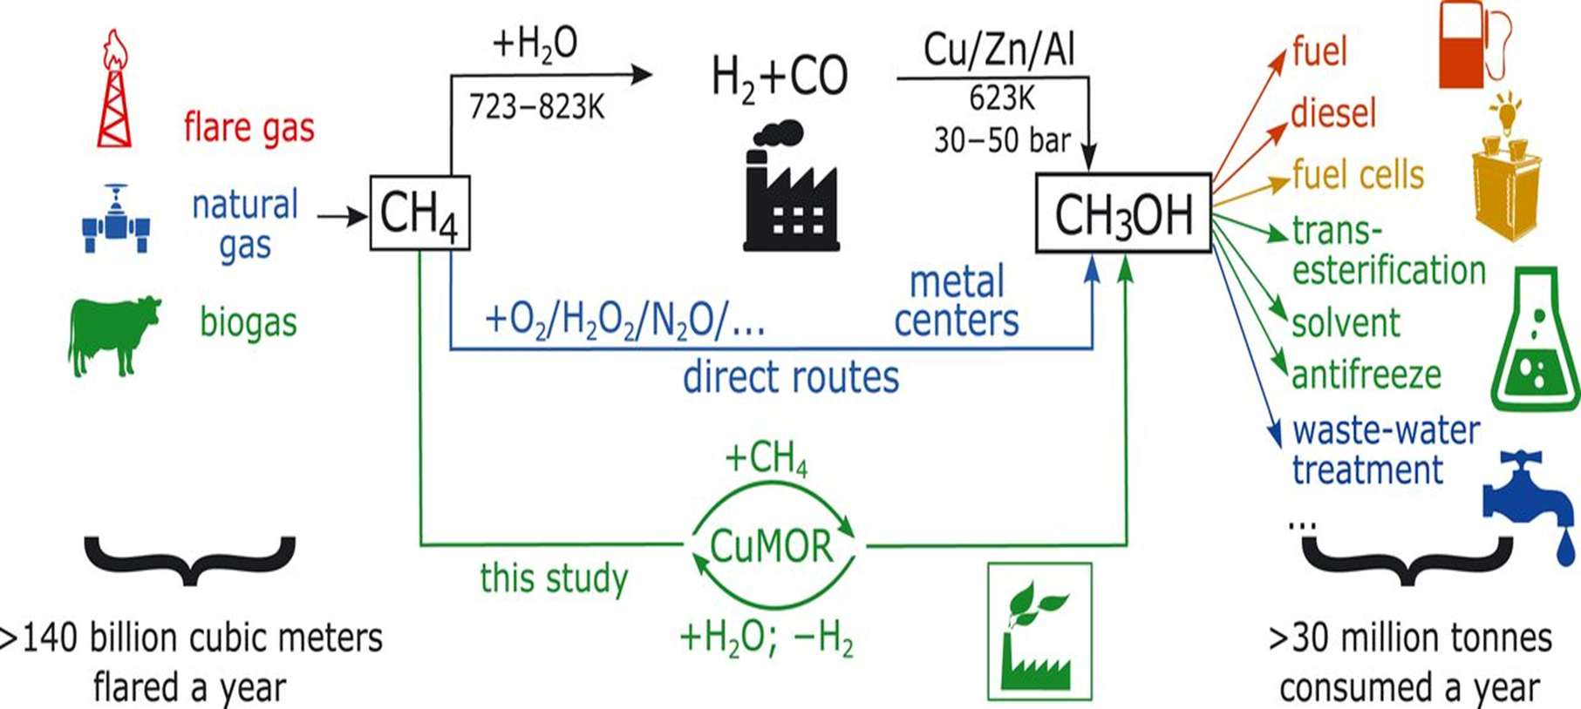
Science, 2017, 356: 523-527.

Slide 4

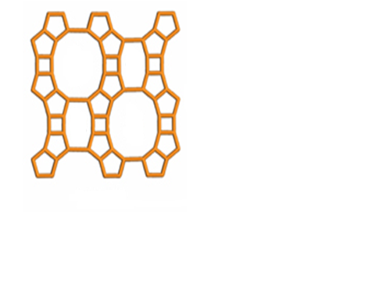
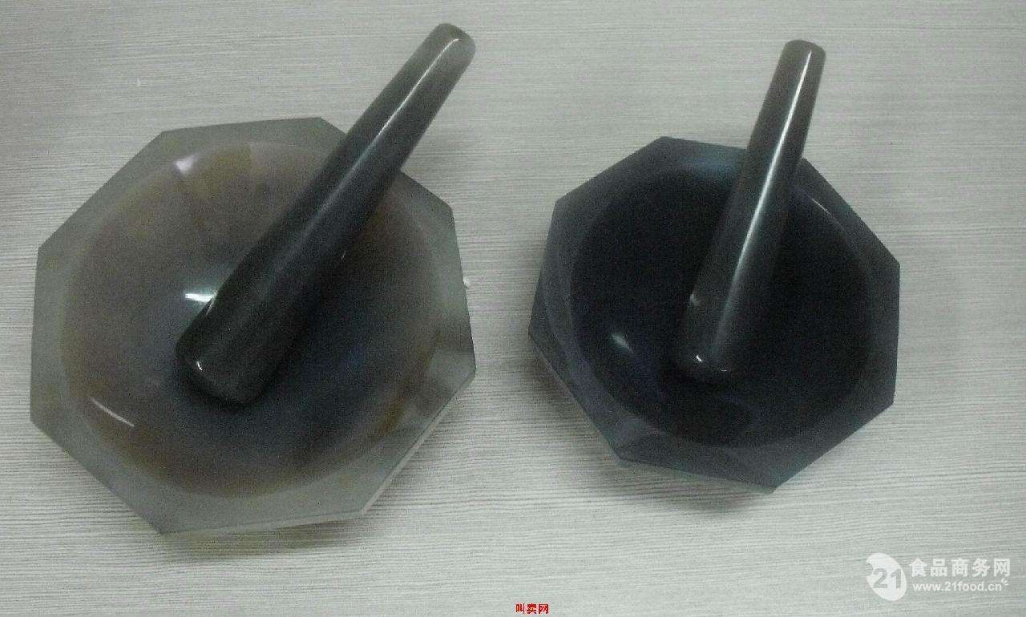
N₂ 900 ℃
Air 500 ℃
Ferrocene
Mordenite
1 hours
Air 150 ℃
4 hours
Solid state ion exchange
x hours
Fe-MOR calcination conditions^{[1][2]}
[1] Journal of Catalysis , 2009 , 264 : 163-174.
[2] Chemistry - A European Journal , 2007 , 13 : 7890 -7899.

Slide 5


Theoretical
CH₄ + N₂O → CH₃OH + N₂
Experimental
4CH₄ + 4N₂O → 2CH₃OH + 2CH₃OCH₃ + HCHO
+ 4N₂ + 3O₂ + 2H₂O + 2CO + 2 CO₂

Slide 6
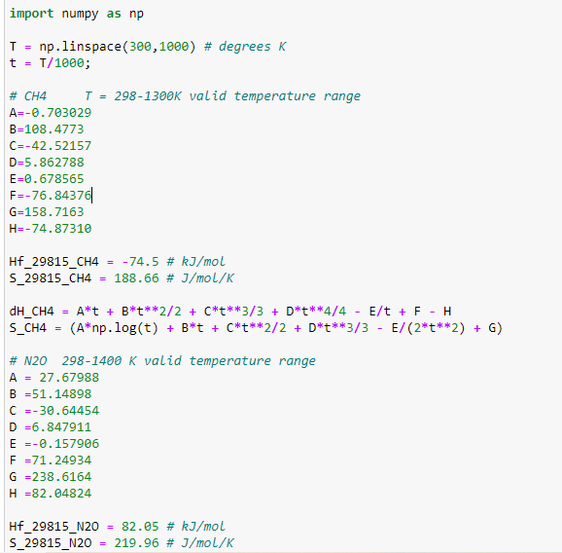
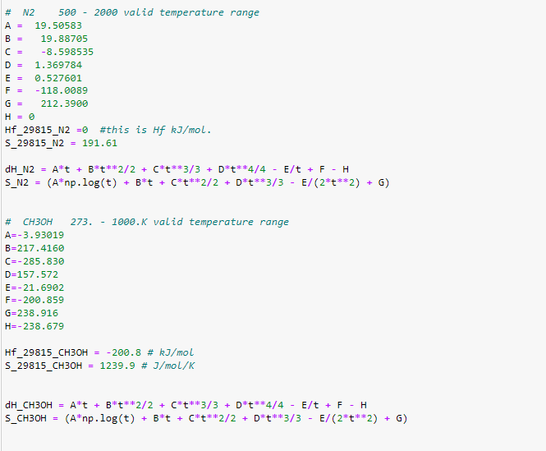
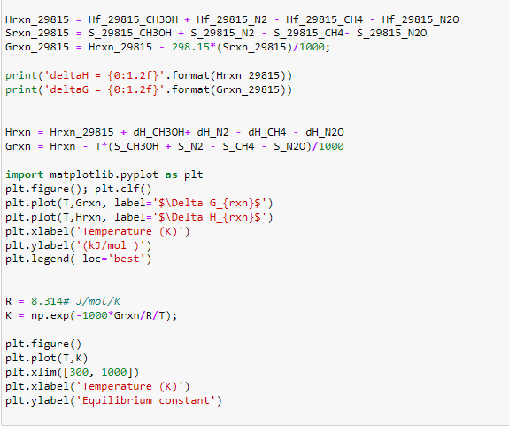
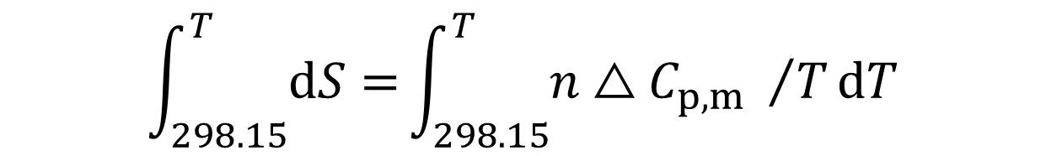
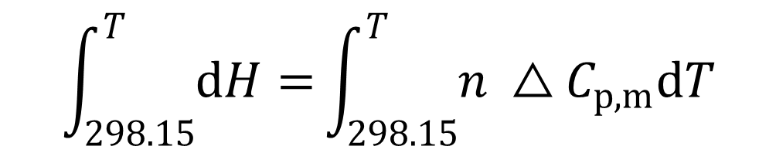
dH = n C_{p,m} dT
$$\int_{298.15}^{T}{dH=}\int_{298.15}^{T}{n △C_{p,m}dT}$$
dS = n C_{p,m}/T dT
$$\int_{298.15}^{T}{dS=}\int_{298.15}^{T}{n△C_{p,m} /TdT}$$
△_{r}G_{m}(T) = △_{r}H_{m}(T) – T △_{r}S_{m}(T)

Slide 7
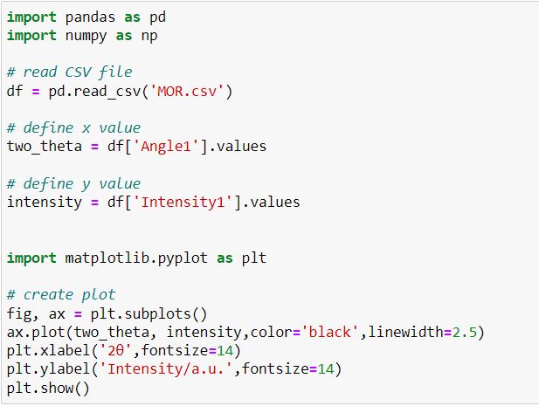
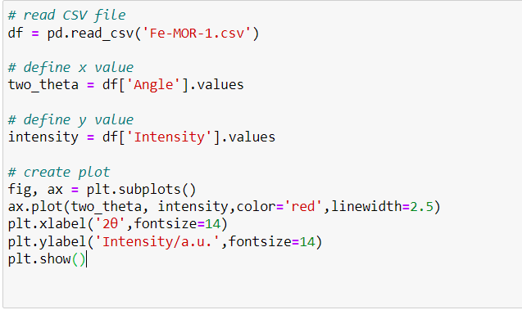
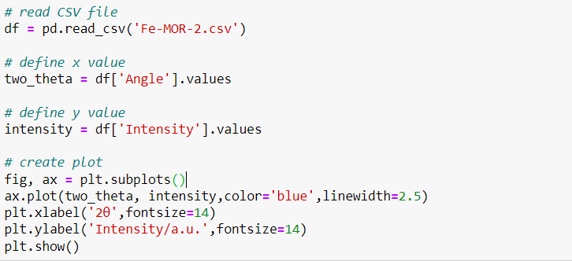
XRD

Slide 8
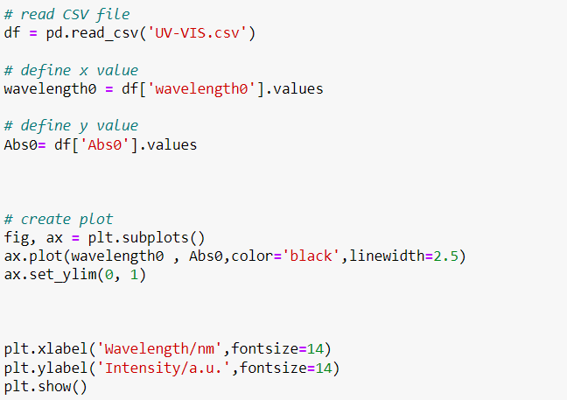
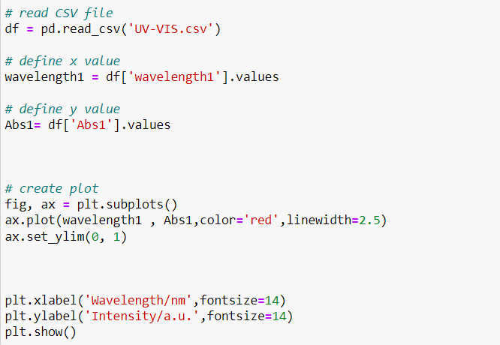
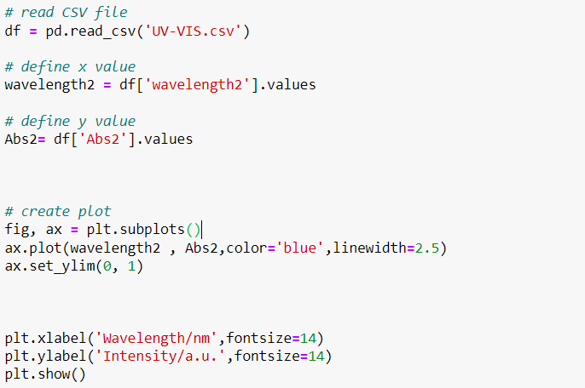
UV-Vis

Slide 9
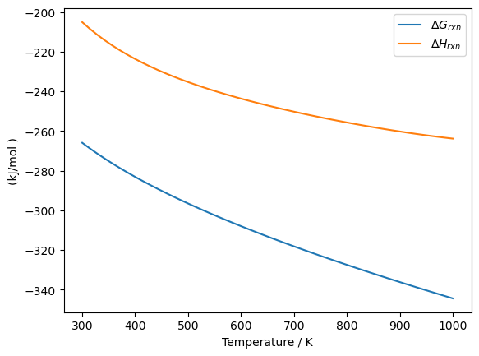
Reaction is feasible
Exothermic
Fig. 1 Enthalpy change and Gibbs free energy change with temperature

Slide 10
Table 1 Physical properties of Fe-MOR catalysts
Catalyst | Si/Al | Fe /(wt.%) | BET Surface Area/(m²/g)
Fe-MOR-0.1 | 24.8 | 0.09 | 376.8
Fe-MOR-0.5 | 24.3 | 0.48 | 370.4
Fe-MOR-1 | 24.7 | 0.93 | 347.5
Fe-MOR-2 | 24.3 | 1.92 | 314.7
Fe-MOR-3 | 24.5 | 2.88 | 278.3
Fe-MOR-0.1, where 0.1 means that the Fe loading is 0.1%, and so on.
Fe loading ≥ 1%, the specific surface area decreases.

Slide 11
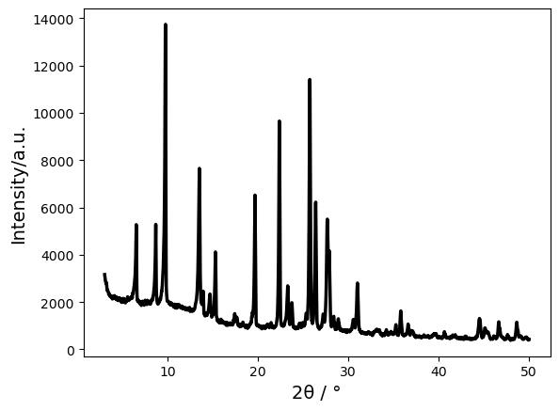
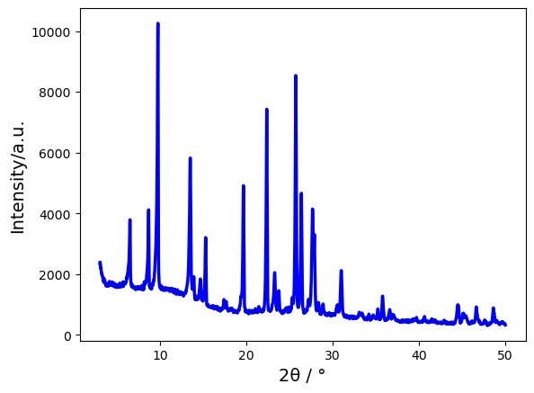
MOR
Fe-MOR
Fig. 2 XRD patterns for MOR and the Fe-MOR catalyst

Slide 12
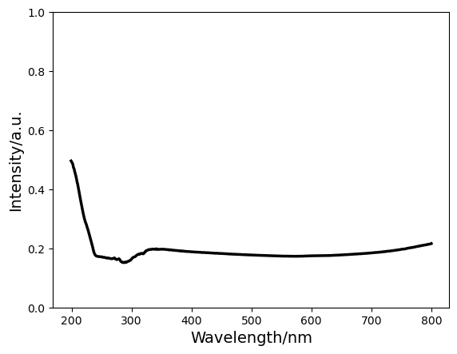
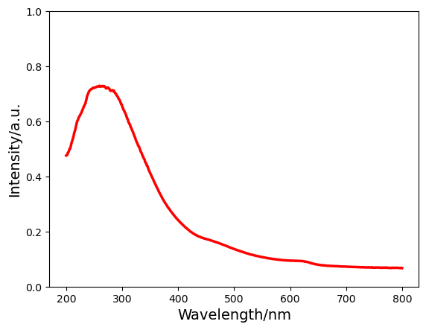
MOR
Fe-MOR
Fig. 3 UV-Vis images for MOR and the Fe-MOR catalyst

Slide 14
Table 2 Performances of Fe-MOR-catalysts for CH₄ Oxidation with N₂O
Catalyst | Average conversion /(%) |  |  | Selectivity / (%)
 | CH₄ | N₂O |  | CH₃OH | HCHO | CH₃OCH₃ | Total oxy- genates | CO_{x}
Fe-MOR-0.1 | 0.3 | 1.1 |  | - | - | 31.4 | 31.4 |  | 68.6
Fe-MOR-0.5 | 0.8 | 2.1 |  | 14.3 | 13.8 | 10.2 | 38.3 |  | 61.6
Fe-MOR-1 | 0.9 | 2.5 |  | 11.8 | 17.4 | 6.8 | 36.0 |  | 64.0
Fe-MOR-2 | 0.8 | 2.2 |  | 12.2 | 10.1 | 7.5 | 29.8 |  | 69.8
Fe-MOR-3 | 0.8 | 2.5 |  | 11.1 | 13.8 | 2.8 | 26.7 |  | 73.3

Slide 15
Conclusion
High temperature calcination did not destroy the basic structure of Fe-MOR catalysts.
The specific surface area of the catalyst gradually decreased with increasing loading Fe content.
The selectivity and yield of oxygenated organics increased with increasing loading Fe content and then decreased.
Fe-MOR-0.5 catalyst was more effective with a total selectivity of 38.4% for oxygenated organics.

Slide 16
Thank you.
Any questions, comments, and suggestions?

